Slide 1


Mathematical Practices and Fractions for Administrators
Barbara Goldammer, Webster Central School District
Linda Sykut, Webster Central School District
Amy Weber-Salgo, Washoe County School District

Slide 2
Learning Outcomes
What knowledge do I need about the Common Core Standards to be able to support teachers’ math instruction?
What questions do I ask and what do I look for in the classroom to support the teacher in implementing the Mathematical Practices?
How do I encourage a teacher to reflect on the interaction between the students and mathematics?

Slide 3
Overview
Fraction Progression 3-5
Standards for Mathematical Practice
Mathematical Practices in the classroom
Notes:
Welcome: Today you will learn about some specific fraction content and will apply the learning to actual classroom video to identify evidence of the mathematical practices.

Slide 4
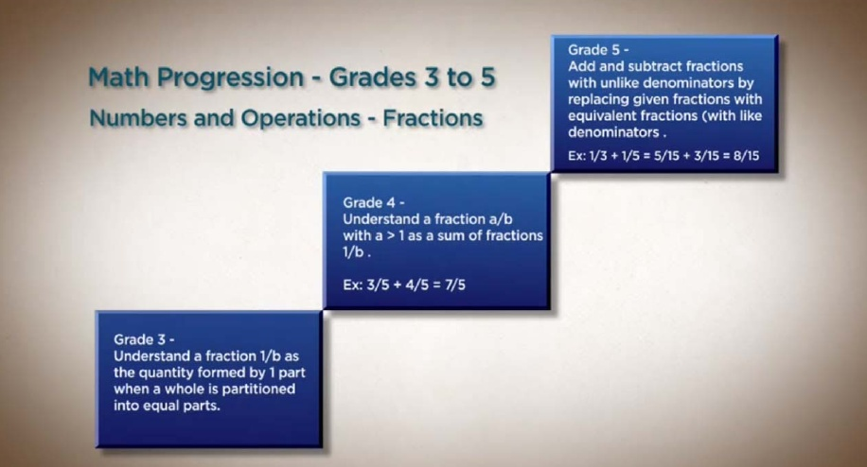
Video
Notes:
Building Background Knowledge. Click on the rectangle in the bottom with to view Bill McCallum providing a two minute overview of the progression of fractions in grades 3-5

Slide 5
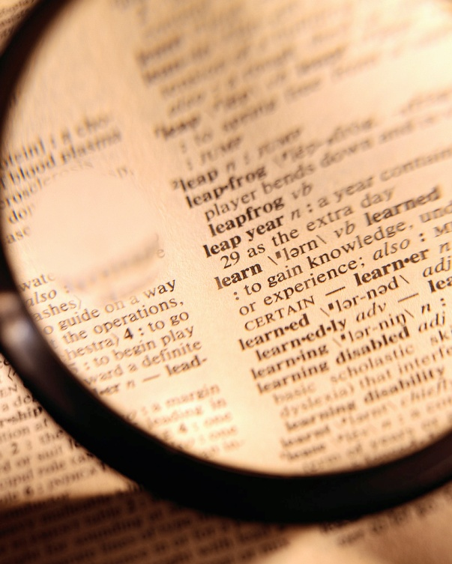
Digging Deep into the Standards

Slide 6
Grade 3:
  Develop an understanding of fractions as numbers.
    Specifying the whole
    Explaining what is meant by “equal parts”
Grade 4:
  Extend understanding of fraction equivalence and ordering.
  Build fractions from unit fractions by applying and extending previous understandings of operations on whole numbers.
  Understand decimal notation for fractions, and compare decimal fractions.
Grade 5:
  Use equivalent fractions as a strategy to add and subtract fractions.
  Apply and extend previous understanding of multiplication and division to multiply and divide fractions
Notes:
Pose the question--- what do you notice about these cluster headings? What are key words, phrases? What inferences can you make?

Slide 7
3. Explain equivalence of fractions in special cases, and compare fractions by reasoning about their size.
  Understand two fractions as equivalent (equal) if they are the same size, or the same point on a number line.
  b. Recognize and generate simple equivalent fractions, e.g., 1/2 = 2/4, 4/6 = 2/3). Explain why the fractions are equivalent, e.g., by using a visual fraction model.
  c. Express whole numbers as fractions, and recognize fractions that are equivalent to whole numbers. Examples: Express 3 in the form 3 = 3/1; recognize that 6/1 = 6; locate 4/4 and 1 at the same point of a number line diagram.
  d. Compare two fractions with the same numerator or the same denominator by reasoning about their size. Recognize that comparisons are valid only when the two fractions refer to the same whole. Record the results of comparisons with the symbols >, =, or <, and justify the conclusions, e.g., by using a visual fraction model.
Notes:
Participants need the doc “Grade 3 Standard Showing Mathematics”. We will be digging deeper and using text based discussion ideas to understand the mathematical concepts.

Slide 8
Digging Deep into the Standards
Text based discussion
  Silently read Grade 3 Fraction Standards
  Annotate your document including pictures that illustrate the mathematical concepts.
At your table on the large flip chart with the Standards,
  Silently….
    What are the key ideas?
    What does it look like for students, teachers?
    What are you wondering?
Discuss
Notes:
Each participant reads and annotates the document by showing their mathematical thinking. What do the standards say? What is the intent of the author…the content?
Provide each table with a flip chart that has a blown up copy of the standards. Participants now engage in a silent conversation on the flip chart. They highlight key phrases, draw diagrams that show the meaning of the words and write their wonderings. They should respond to other table mates writings.
After about 7-10 minutes, allow discussion to begin..what does this learning look like in the classroom for the student and for the teacher.
Admin– How could you use this activity

Slide 9
Big Idea: Develop understanding of fractions as numbers.
3.NF.1. Understand a fraction 1/b as the quantity formed by 1 part when a whole is partitioned into b equal parts; understand a fraction a/b as the quantity formed by a parts of size 1/b.
3.NF.2. Understand a fraction as a number on the number line; represent fractions on a number line diagram.
  Represent a fraction 1/b on a number line diagram by defining the interval from 0 to 1 as the whole and partitioning it into b equal parts. Recognize that each part has size 1/b and that the endpoint of the part based at 0 locates the number 1/b on the number line.
  Represent a fraction a/b on a number line diagram by marking off a lengths 1/b from 0. Recognize that the resulting interval has size a/b and that its endpoint locates the number a/b on the number line.
3.NF.3. Explain equivalence of fractions in special cases, and compare fractions by reasoning about their size.
  Understand two fractions as equivalent (equal) if they are the same size, or the same point on a number line.
  Recognize and generate simple equivalent fractions, e.g., 1/2 = 2/4, 4/6 = 2/3). Explain why the fractions are equivalent, e.g., by using a visual fraction model.
  Express whole numbers as fractions, and recognize fractions that are equivalent to whole numbers. Examples: Express 3 in the form 3 = 3/1; recognize that 6/1 = 6; locate 4/4 and 1 at the same point of a number line diagram.
  Compare two fractions with the same numerator or the same denominator by reasoning about their size. Recognize that comparisons are valid only when the two fractions refer to the same whole. Record the results of comparisons with the symbols >, =, or <, and justify the conclusions, e.g., by using a visual fraction model.
My Fraction Unit
March 5th-23rd
What does this mean in the big picture of learning mathematics?
Notes:
Introducing a new unit, your teachers are planning, but what does this mean in the big picture for the year?

Slide 10
Big Idea: Develop understanding of fractions as numbers.
3.NF.3a Understand two fractions as equivalent (equal) if they are the same size, or the same point on a number line.
3.NF.1. Understand a fraction 1/b as the quantity formed by 1 part when a whole is partitioned into b equal parts; understand a fraction a/b as the quantity formed by a parts of size 1/b.
3.MD.1 Tell and write time to the nearest minute and measure time intervals in minutes. Solve word problems involving addition and subtraction of time intervals in minutes, e.g., by representing the problem on a number line diagram.
3.MD.4 Generate measurement data by measuring lengths using rulers marked with halves and fourths of an inch. Show the data by making a line plot, where the horizontal scale is marked off in appropriate units— whole numbers, halves, or quarters.
3.OA.2 Interpret whole-number quotients of whole numbers, e.g., interpret 56 ÷ 8 as the number of objects in each share when 56 objects are partitioned equally into 8 shares, or as a number of shares when
56 objects are partitioned into equal shares of 8 objects each.
3.G.2 Partition shapes into parts with equal areas. Express the area of each part as a unit fraction of the whole. For example, partition a shape into 4 parts with equal area, and describe the area of each part as 1/4 of the area of the shape.

Slide 11
Big Idea: Develop understanding of fractions as numbers
My fraction teaching takes place all year long, with a deep focus at intervals throughout the year. I can use the language of fractions to help me teach measurement, geometry, and operations and I can use the language from the other domains to help me teach fractions.
X
My Fraction Unit
March 5th-23rd

Slide 12
Using what I just learned, what questions will I ask students during the learning walk?
In an opportunity during a follow-up conversation with the teacher, what are potential questions I will ask?

Slide 13
Standards for Mathematical Practice
Make sense of problems and persevere in solving them
Reason abstractly and quantitatively
Construct viable arguments and critique the reasoning of others
Model with mathematics
Use appropriate tools strategically
Attend to precision
Look for and make use of structure
Look for and express regularity in repeated reasoning

Slide 14
What are the first three words in each mathematical practice?
Mathematically proficient students….

Slide 15
MP 1: Make sense of problems and persevere in solving them.
Mathematically Proficient Students:
Explain the meaning of the problem to themselves
Look for entry points
Analyze givens, constraints, relationships, goals
Make conjectures about the solution
Plan a solution pathway
Consider analogous problems
Try special cases and similar forms
Monitor and evaluate progress, and change course if necessary
Check their answer to problems using a different method
Continually ask themselves “Does this make sense?”
Gather Information
Make a plan
Continuously evaluate progress
Check results
Question sense of solutions
Anticipate possible solutions

Slide 16
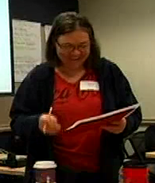
MP 2: Reason abstractly and Quantitatively
Decontextualize
Represent as symbols, abstract the situation
Contextualize
Pause as needed to refer back to situation
5
Mathematical Problem
½
P
x x x x
TUSD educator explains SMP #2 - Skip to minute 5

Slide 17
MP 3: Construct viable arguments and critique the reasoning of others
Use assumptions, definitions, and previous results
Make a conjecture
Build a logical progression of statements to explore the conjecture
Analyze situations by breaking them into cases
Recognize and use counter examples
Distinguish correct logic
Communicate conclusions
Explain flaws
Justify conclusions
Respond to arguments
Ask clarifying questions

Slide 18
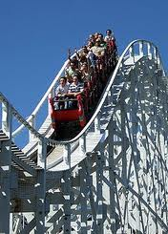
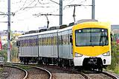
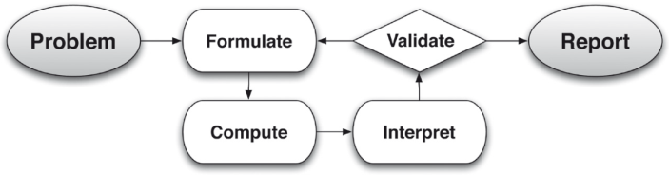
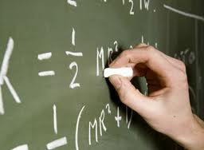
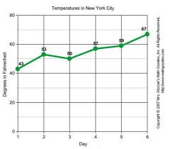
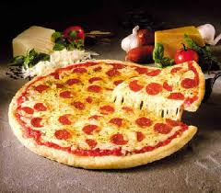
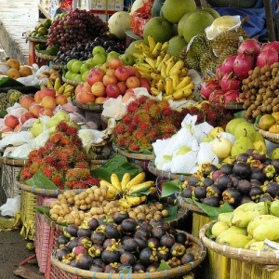
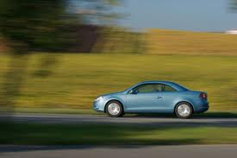
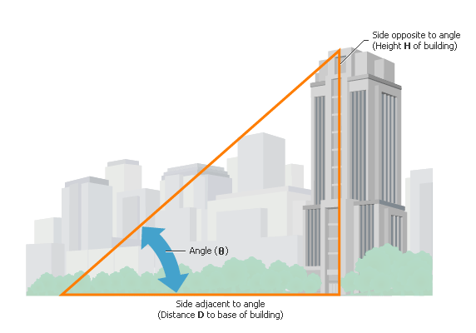
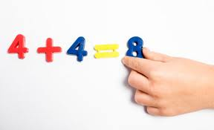
MP 4: Model with mathematics
Problems in everyday life…
…reasoned using mathematical methods
Mathematically proficient students:
Make assumptions and approximations to simplify a Situation, realizing these may need revision later
Interpret mathematical results in the context of the situation and reflect on whether they make sense

Slide 19
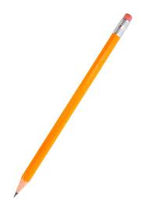
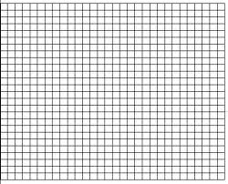
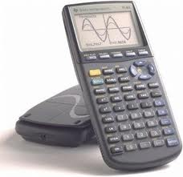
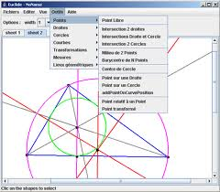
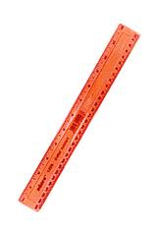
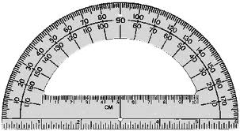
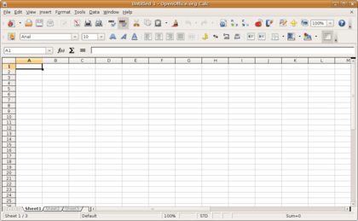
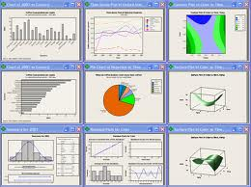
MP 5: Use appropriate tools strategically
Proficient students:
Are sufficiently familiar with appropriate tools to decide when each tool is helpful, knowing both the benefit and limitations
Detect possible errors
Identify relevant external mathematical resources, and use them to pose or solve problems

Slide 20
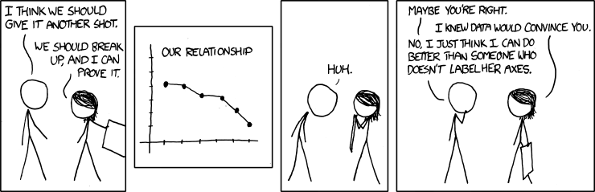
MP 6: Attend to Precision
Mathematically proficient students:
  communicate precisely to others
  use clear definitions
  state the meaning of the symbols they use
  specify units of measurement
  label the axes to clarify correspondence with problem
  calculate accurately and efficiently
  express numerical answers with an appropriate degree of precision
Comic: http://forums.xkcd.com/viewtopic.php?f=7&t=66819

Slide 21
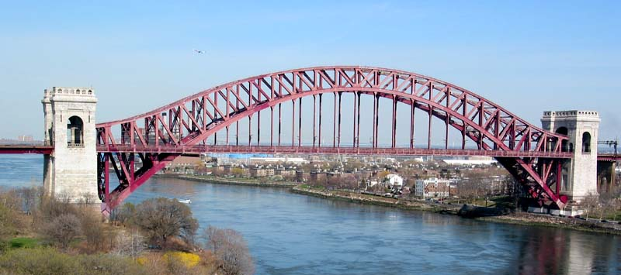
MP 7: Look for and make use of structure
Mathematically proficient students:
  look closely to discern a pattern or structure
  step back for an overview and shift perspective
  see complicated things as single objects, or as composed of several objects

Slide 22
MP 8: Look for and express regularity in repeated reasoning
Mathematically proficient students:
  notice if calculations are repeated and look both for general methods and for shortcuts
  maintain oversight of the process while attending to the details, as they work to solve a problem
  continually evaluate the reasonableness of their intermediate results

Slide 23
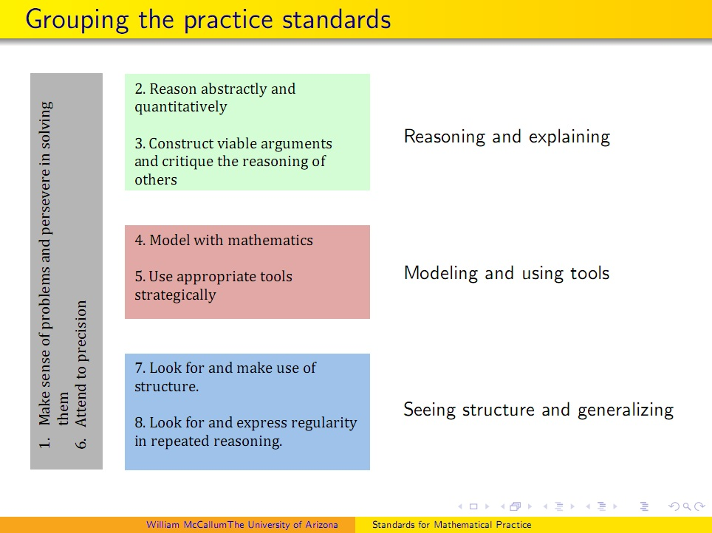

Slide 24
Mathematically proficient students …
Using what I just learned, what questions will I ask students during the learning walk?
In an opportunity during a follow-up conversation with the teacher, what are potential questions I will ask?

Slide 25
What’s the difference?
Show your work….
Show your mathematical thinking….

Slide 26
Grade 3 Fraction Standards
Compare the following fractions, show your mathematical thinking
  2/3 and 7/3
  2/3 and 2/6
Notes:
Use models, visuals and diagrams to show your thinking….
Each participant compares the fraction and uses diagrams, visuals and models to show their mathematical thinking. Then, with a partner they discuss their conclusion and justify with evidence.

Slide 27
Standards for Mathematical Practice
Make sense of problems and persevere in solving them
Reason abstractly and quantitatively
Construct viable arguments and critique the reasoning of others
Model with mathematics
Use appropriate tools strategically
Attend to precision
Look for and make use of structure
Look for and express regularity in repeated reasoning
Notes:
Choose two Mathematical Practices that you have taught your teachers – use the chart to group together. Discuss how these MP we illustrated in the video

Slide 28
Show your mathematical thinking…
Using what I just learned, what questions will I ask students during the learning walk?
In an opportunity during a follow-up conversation with the teacher, what are potential questions I will ask?

Slide 29
Mathematical Practices in the classroom
Choose a video from facilitator’s resources or other relevant math classroom video.
Notes:
View the video and identify the two mathematical practices in the video

Slide 30
Standards for Mathematical Practice
Make sense of problems and persevere in solving them
Reason abstractly and quantitatively
Construct viable arguments and critique the reasoning of others
Model with mathematics
Use appropriate tools strategically
Attend to precision
Look for and make use of structure
Look for and express regularity in repeated reasoning
Notes:
Choose two Mathematical Practices that you have taught your teachers – use the chart to group together. Discuss how these MP we illustrated in the activity of comparing fractions and showing your mathematical thinking.

Slide 31
Mathematical Practices
Using what I just learned, what questions will I ask students during the learning walk?
In an opportunity during a follow-up conversation with the teacher, what are potential questions I will ask?

Slide 32
Next Steps
In our next learning experience together
Bring evidence of
  Mathematical Practices
  Students’ mathematical thinking

